Slide 1
Liver Patient Analysis
Team Insights

Slide 2
Contents :
Introduction
Dataset
Data-Preprocessing
Exploratory Data Analysis
Data Modelling & Performance Evaluation
Prediction Score
Deployment in Web & Android App
Conclusion

Slide 3
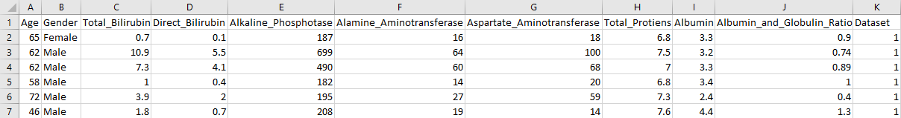
Dataset :
This dataset was downloaded from the UCI ML Repository : Lichman, M. (2013). UCI Machine Learning Repository [http://archive.ics.uci.edu/ml]. Irvine, CA: University of California, School of Information and Computer Science.
The dataset contains 583 * 11 [rows X columns]. It has a general description about patient’s personal information and the values of various tests like Age, Gender, Total bilirubin, Direct bilirubin, Alkaline phosphotase, Alamine aminotransferase, Aspartate Aminotransferase, Total proteins, Albumin, Albumin-Globulin ratio.
The dependent variable is binary as it has either the person has a positive outcome of disease or not with respect to the test values.

Slide 4
Data-Preprocessing :
3.1-Missing Values :
The missing values can be either replaced with statistical terms on a column or can also be dropped if they don’t affect the data. Since the missing data is 0.6% in the data, dropping the data will not end is loss of information from the data.
3.2-LabelEncoder :
Label Encoder is used in turning the objects from categorical to numerical and since there is only one column “Gender” which has Boolean values, so Female/Male are changed to 0/1 respectively.
3.3-Standardization :
Since the variance among the data in all the columns is spread across huge numbers, we use standardization to convert values from ranging from huge values to a value which has mean of 0 and standard deviation of 1.

Slide 5
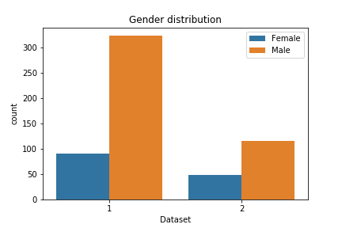
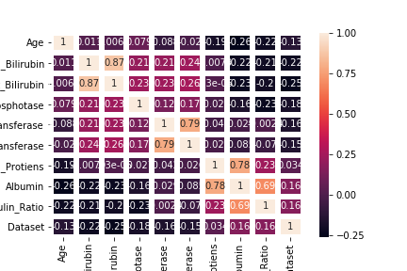
Exploratory Data Analysis :
After cleaning the and pre-processing the data, now we explore the data with various visualizations.
We check for the count of people who had disease and not with the “Gender” perspective and list the values.
We check for correlation among all the columns to have a look over the correlation among the columns in the dataset.

Slide 6
Data Modelling & Performance Evaluation :
Random Forest :
It is a ensemble technique, which is dependent over Decision trees where multiple decision trees are calculated and their mean of multiple classes are taken as the output class label.
There can be Numerous number of trees added as per the requirement and the accuracy can vary depending on the number of trees selected.
Sometimes the default number of trees is 10 and can be changeable.
Accuracy is calculated by the total number of correctly predicted values to the actual values in the dataset after the data is split in to train set and test set. Accuracy is calculated on the test set with the predicted values.

Slide 7
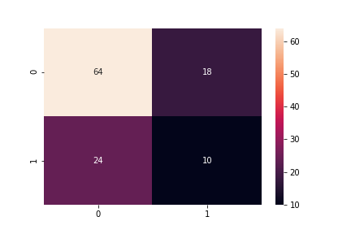
Performance metrics :
The Confusion matrix returns the True Positive Rate, False Positive Rate, True Negative Rate & False Negative Rate. It gives the actual and predicted values of the model which gives the accuracy how good the model is.
The confusion matrix is calculated by a function in sklearn package under metrics class.
It is then visualised by either as a DataFrame or by Plotting a heatmap.

Slide 8

Prediction Score :
The predicted accuracy we get after the model which has the 100000 trees is 69.04% and with 10000 trees we get 68.02 %.
After Cross Validation we get a accuracy of 70.05% with a cv value of 10.
The roc_auc value for the random forest model is 59.88% and the decrease in value is because of the imbalanced dataset which has high positive values and less negative values from which we can say that the model is slightly biased towards the positive values and affecting the accuracy of the model.
The final model which we will use to deploy is the random forest model which has 69.04% and a cross validated score is ranging nearer to the normal model accuracy.
Hence the model is deployed to the node red and android studio where the accuracy is ranging nearer to 70%.

Slide 9
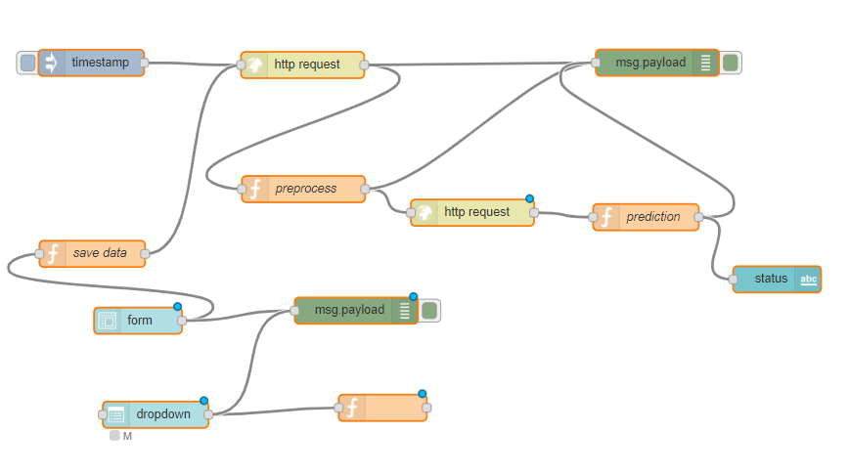
Deployment In Web :
The connection is created in IBM Watson with the credentials and the scoring endpoint and is then given to the Node-Red connection where the forms are created with GET method and the values are set using the SET method. The POST method returns the values through the scoring endpoint created in the model. These are created with a User Interface and the output is returned.

Slide 10

Deployment in Android :
The user-interface of the machine learning model is developed as a android application by which patients can enter the values to predict and the doctors can view all the patient’s predicted report.
The android application is connected to ibm-cloud via node red where the prediction is done and the result is sent back to the mobile application.
The application consists of patient login and doctor login separately, using patient-id every patient can view their report and doctor can view all patient’s report

Slide 11
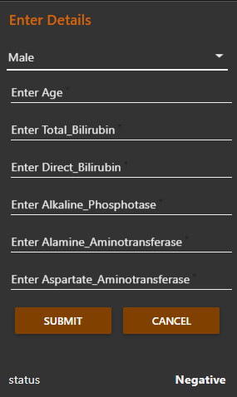
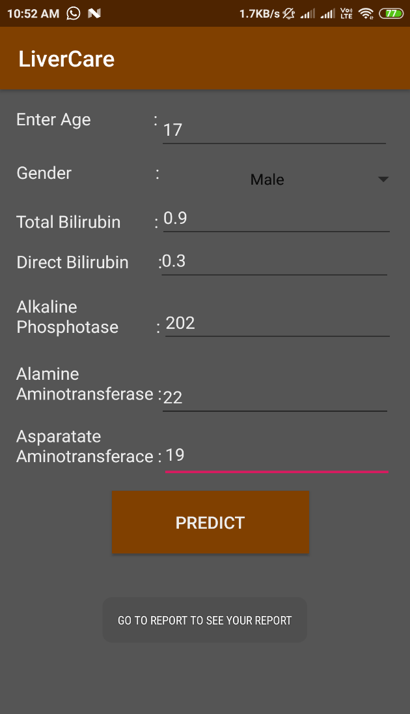
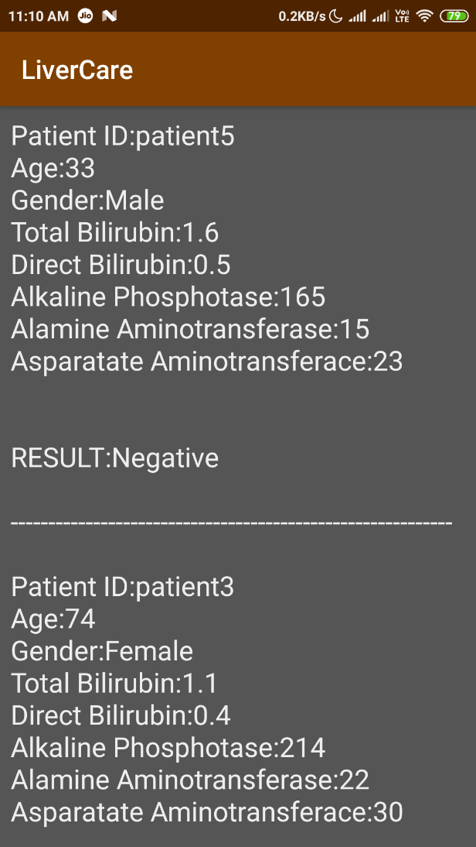
User Interface in Web and App :

Slide 12





Conclusion :
The final Outcome is where the values regarding the tests must be entered by the patient after their respective test results, The Machine learning model built with random forest deployed using IBM cloud and integrated with Node-Red for web form and android studio for mobile application returns the prediction of either the person has the disease or not. The respective information is sent to their concern doctor and the doctor will have the reports in the LiverCare App.

Slide 13
Team Members :
Suhail Hafiz Khan .J [Cse]
Vikash .M [Cse]
Tamil Mani .M [Cse]
Vijaiarivalagan .K [Cse]

